Slide 1
Welcome to our presentation

Slide 2

XYZ Company
We are for you

Slide 3
In This Presentation
Company overview
Future Goals
Products
Market analysis
Financial Highlights

Slide 4
XYZ Company
XYZ Company Electronics, a flagship subsidiary of the XYZ Company Group, is a global leader in technology and consumer electronics.
Established in 1998
XYZ Company is renowned for its
Galaxy series of smartphones
tablets
QLED and OLED Monitor
Television
The company's semiconductor division is a major supplier of memory chips, processors, and display panels, serving both its own products and other leading tech brands.
Through groundbreaking innovations like foldable smartphones, AI-powered appliances, and its Internet of Things (IoT) platform

Slide 5
OUR SPECIALITY
Performance growth
Vision New
Requirements fulfil
Changes & Improve
Evaluate technology
Positive Results

Slide 6
1998
A Startup company with five employ and very little capital
2024
A biggest company of the country with more than 10,000 employ and 5 billion profit

Slide 7
Goals
Global Expansion
Merging Technologies
Flexible Display
Expansion AI
Lead in 5G

Slide 8
Product and Services
Home Appliances
Smartphone
Services
Semiconductor component
Computer

Slide 9
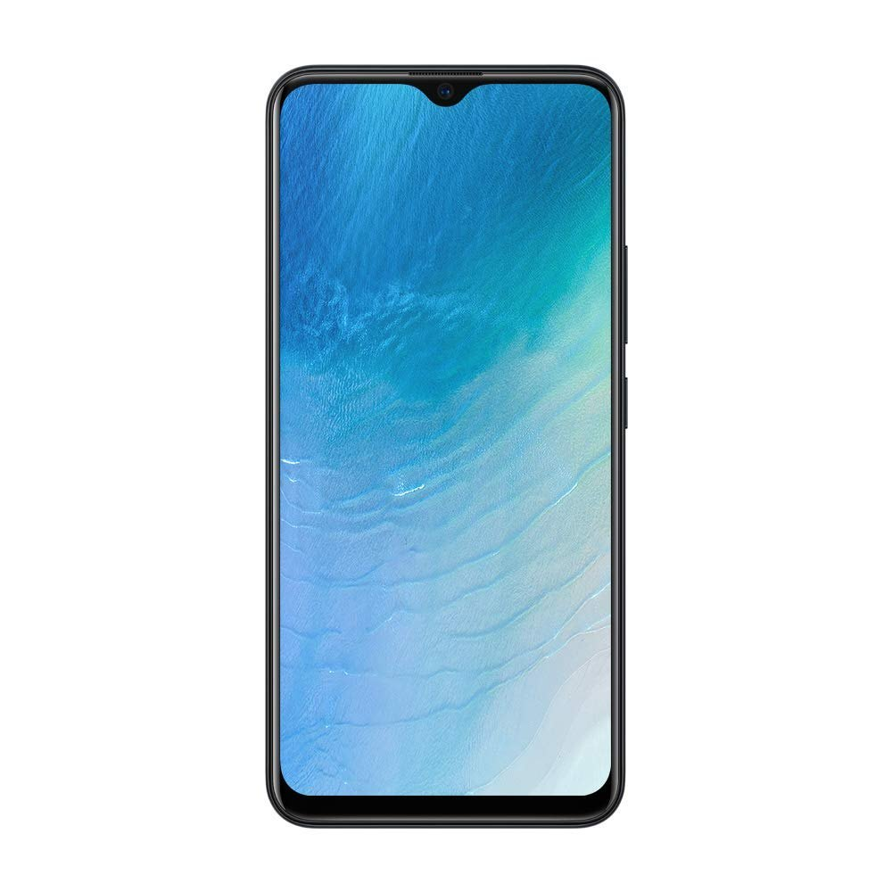

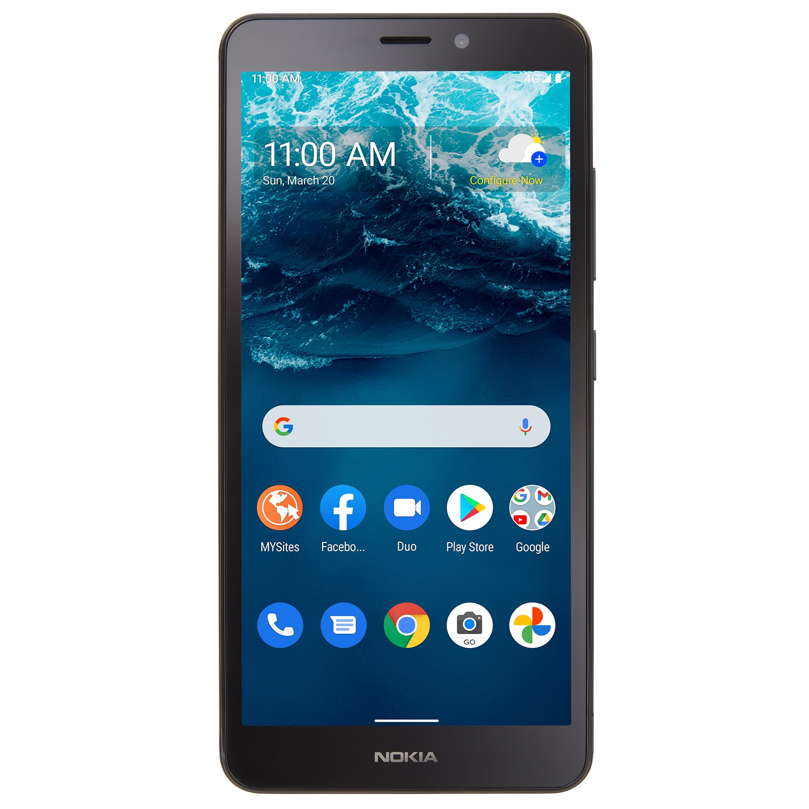
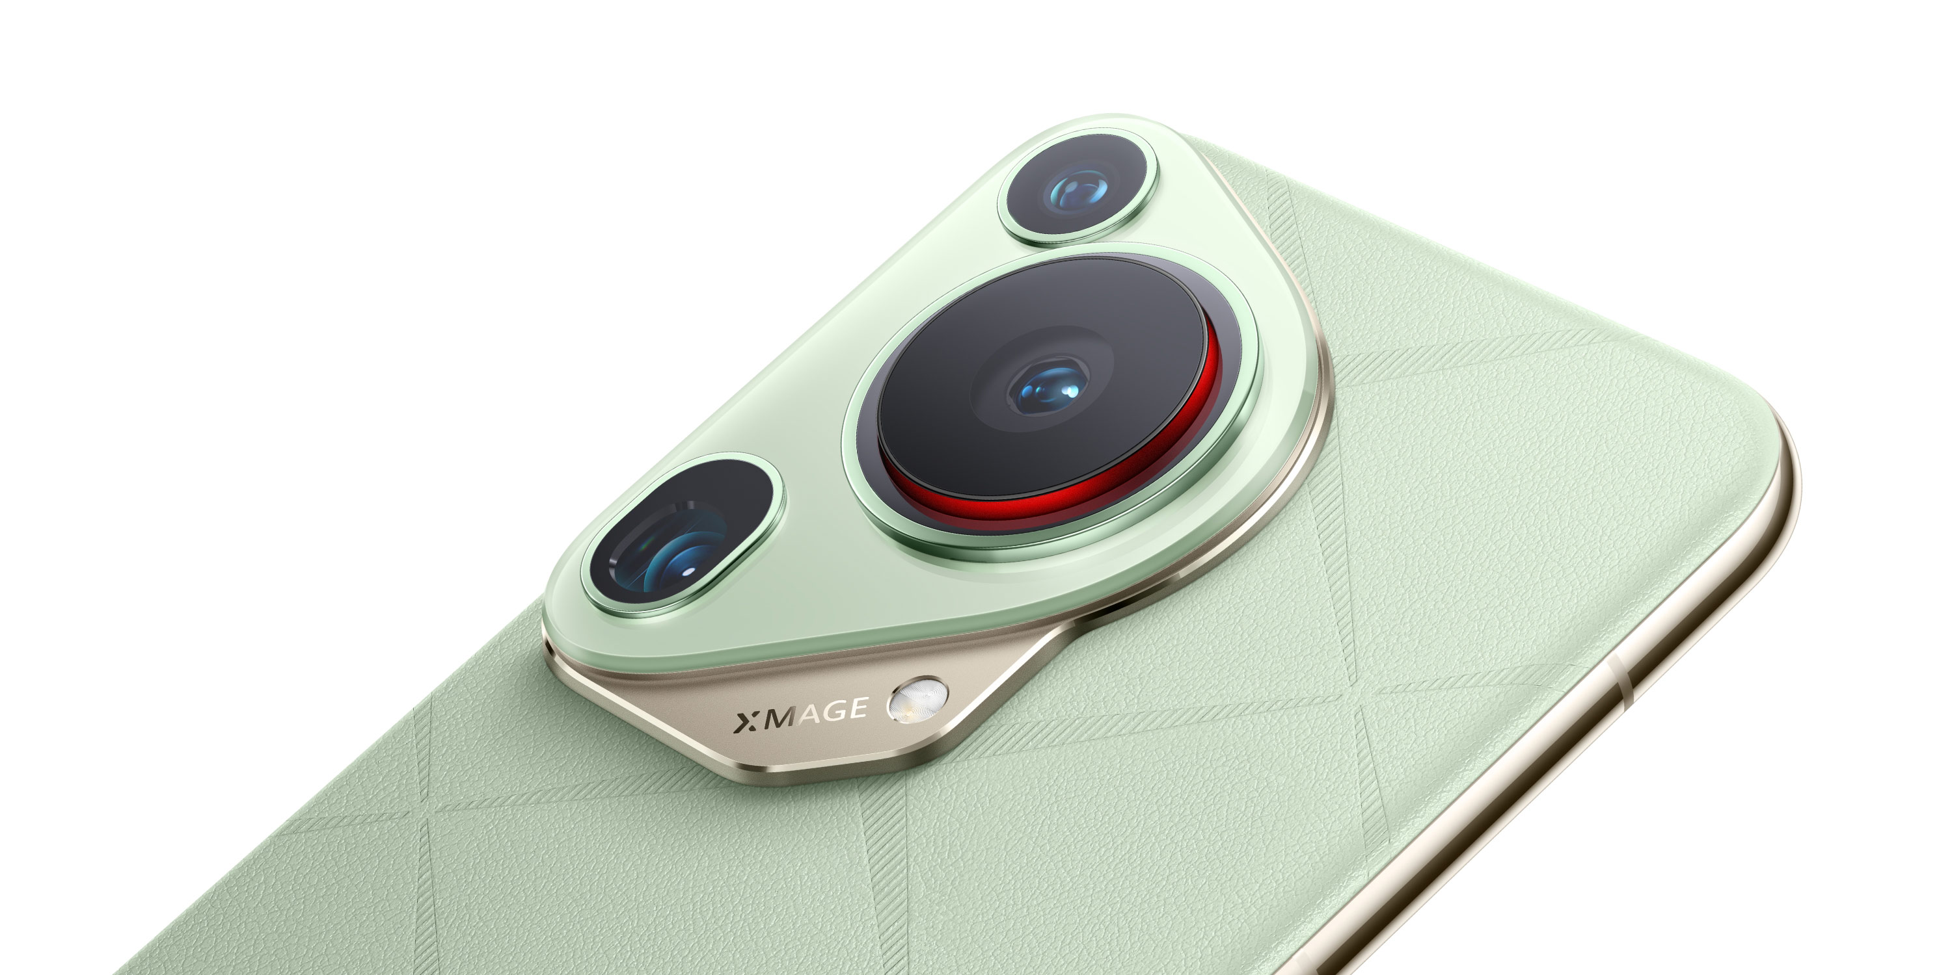
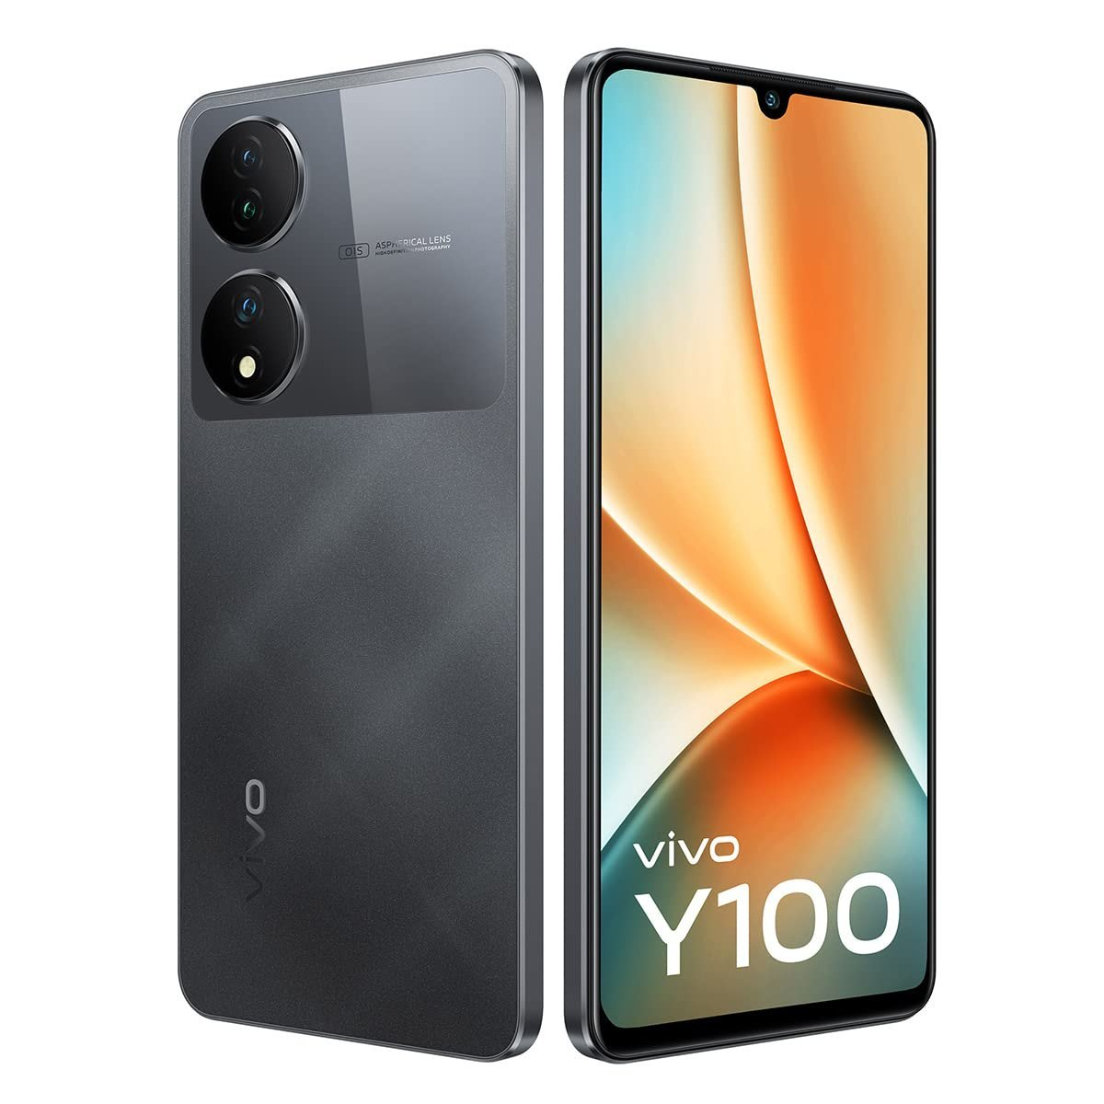
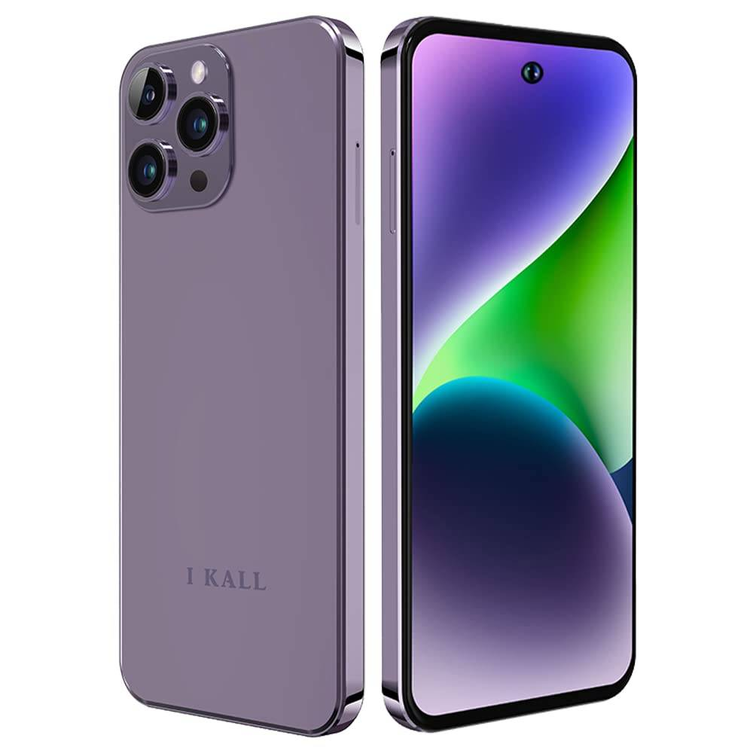
Smartphone
A20 pro
A 50s Pro
Flip X9
J8a
Cam 09
Galaxy Y6

Slide 10
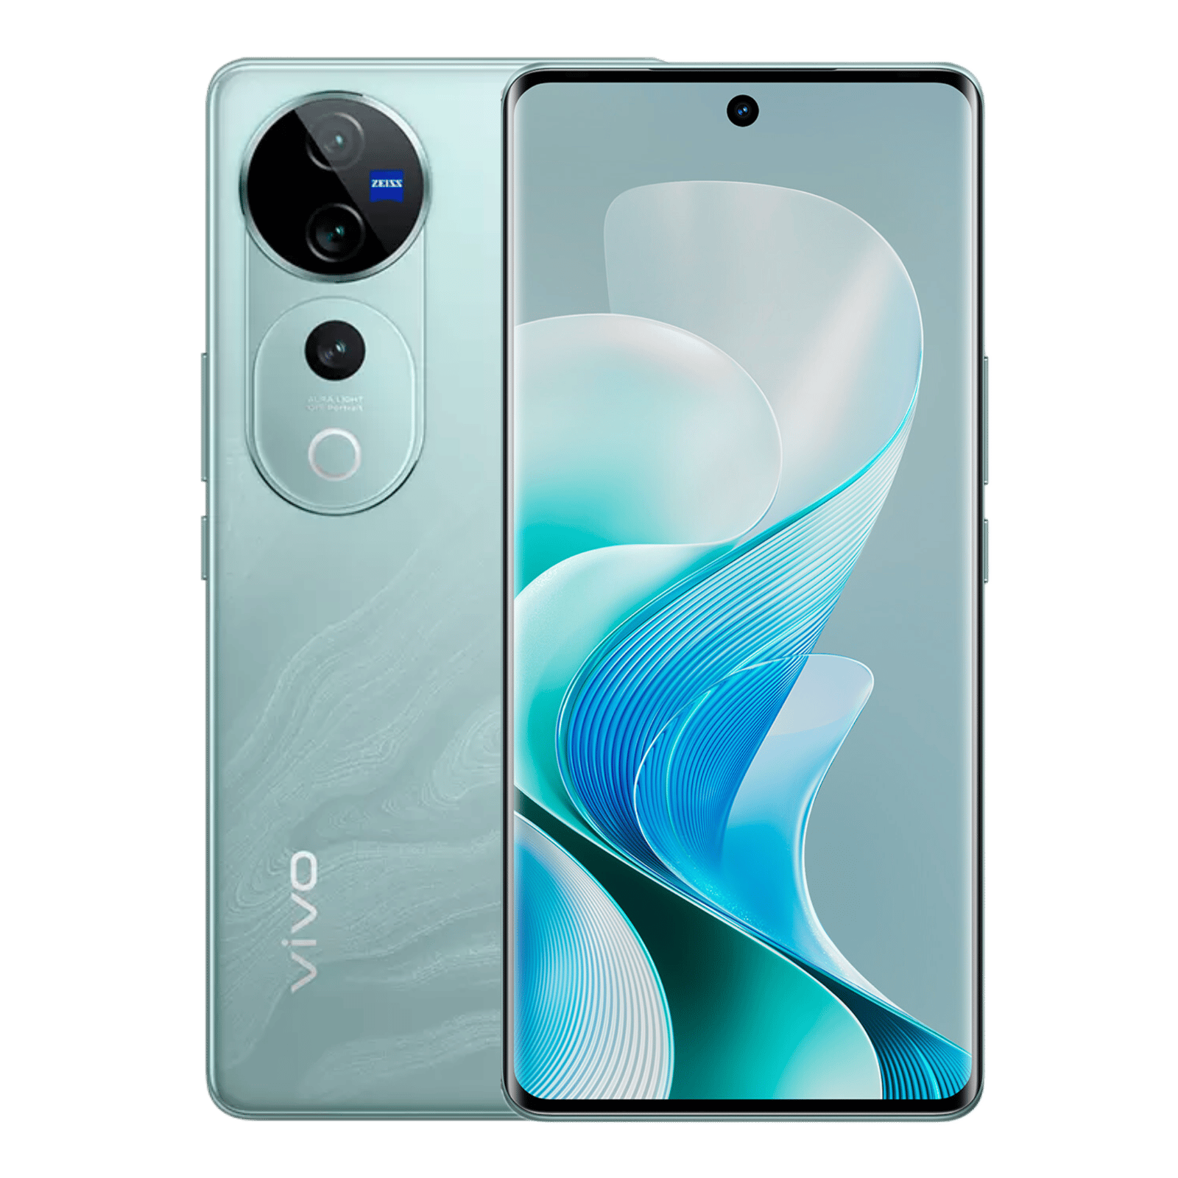
Next
Big
Thing

Slide 11
Galaxy vivo Y10 pro

Slide 12

Galaxy vivo Y10 pro

Slide 13






Home Appliances
Refrigerator
Television
Washing machine
Electric oven
Water heater
Printer

Slide 14
Semiconductor component
Memory Chips
DRAM, SSDs, and NAND flash storage
Processors
Exynos chipsets for smartphones and other devices
Displays
AMOLED and Super AMOLED screens for devices, and display

Slide 15
Services we Offer
1
XYZ Company Pay
5
XYZ Company Knox
2
XYZ Company Health
6
XYZ Company Care+
3
3
Bixby
7
Enterprise Solutions
3
4
Smart Things
1
8
AI Intelligent

Slide 16
Age wise use our products
55%
45%
27%
16-19
20-30
31-40
41-50
51-60
60+
29%
64%
46%

Slide 17
Market Analysis
People of this group of age mostly use Smart Phone
People of this group of age mostly use Home Appliances
16-20
21-30
31-40
41-50
51-60+
People of this group of age mostly use Smart Watch
People of this group of age mostly use Computer
People of this group of age mostly use Television

Slide 18
Region wise Total sales
Highest Sales
Dhaka 5850000
Lowest Sales
Khulna 4110000

Slide 19
Balance Sheet of 2024
Total Revenue
15,000,000,000
↑ 12% YoY
Gross Profit
9,500,000,000
↑ 15% YoY
Net Profit
3,200,000,000
↓ 5% YoY
Operating Expenses
6,000,000,000
↑ 18% YoY
Net Loss
500,000,000
↓ 5% YoY

Slide 20
Product wise Total Sales
Row Labels | Sum of Total Sales (BDT)
Desktop | 6950000
Laptop | 12250000
Smartphone | 6150000
Tablet | 3320000
Grand Total | 28670000

Slide 21
Total product seals
Month | Total Product
January | 205
February | 244
March | 236

Slide 22
Yearly Sales , Expenses & Profit 2024

Slide 23
Yearly Sales , Expenses & Profit 2024
Highest
Lowest
Sales
July 15543600
November 4809300
Expense
July 9976500
November 4534800
Profit
July 1567100
January 538500

Slide 24
Final thoughts
The report highlights the company’s potential for sustainable growth despite current challenges.
Despite robust revenue growth, the decline in net profit signals inefficiencies in expense management.
Interest payments rose by 8% due to debt refinancing at higher rates, further squeezing net profit margins.
Underperforming segments, particularly physical retail, contributed significantly to the overall loss, requiring strategic intervention.

Slide 25
Contact us
XYZ Company
Address: Dakshinkhan ,Uttara,Dhaka-1230
Sales enquiry: 01712-3456789
Service Support: 01923-456789
Email: info@xyzcompany.com

Slide 26
THANKS

